Slide 1
Kiertotalous Tampereen yliopiston profiloitumisalueena Jukka Rintala Kaupunkien kestävä muutos – urbaani kiertotalousyhteistyö, Tampere 3.-4.9.2019.
Human
Potential
Unlimited.

Slide 2
URBAN PLATFORM FOR CIRCULAR ECONOMY (UPCE, 2018) - Circular economy in urban living labs
technological solutions
societal dynamics
new business models
Human
Potential
Unlimited.

Slide 3
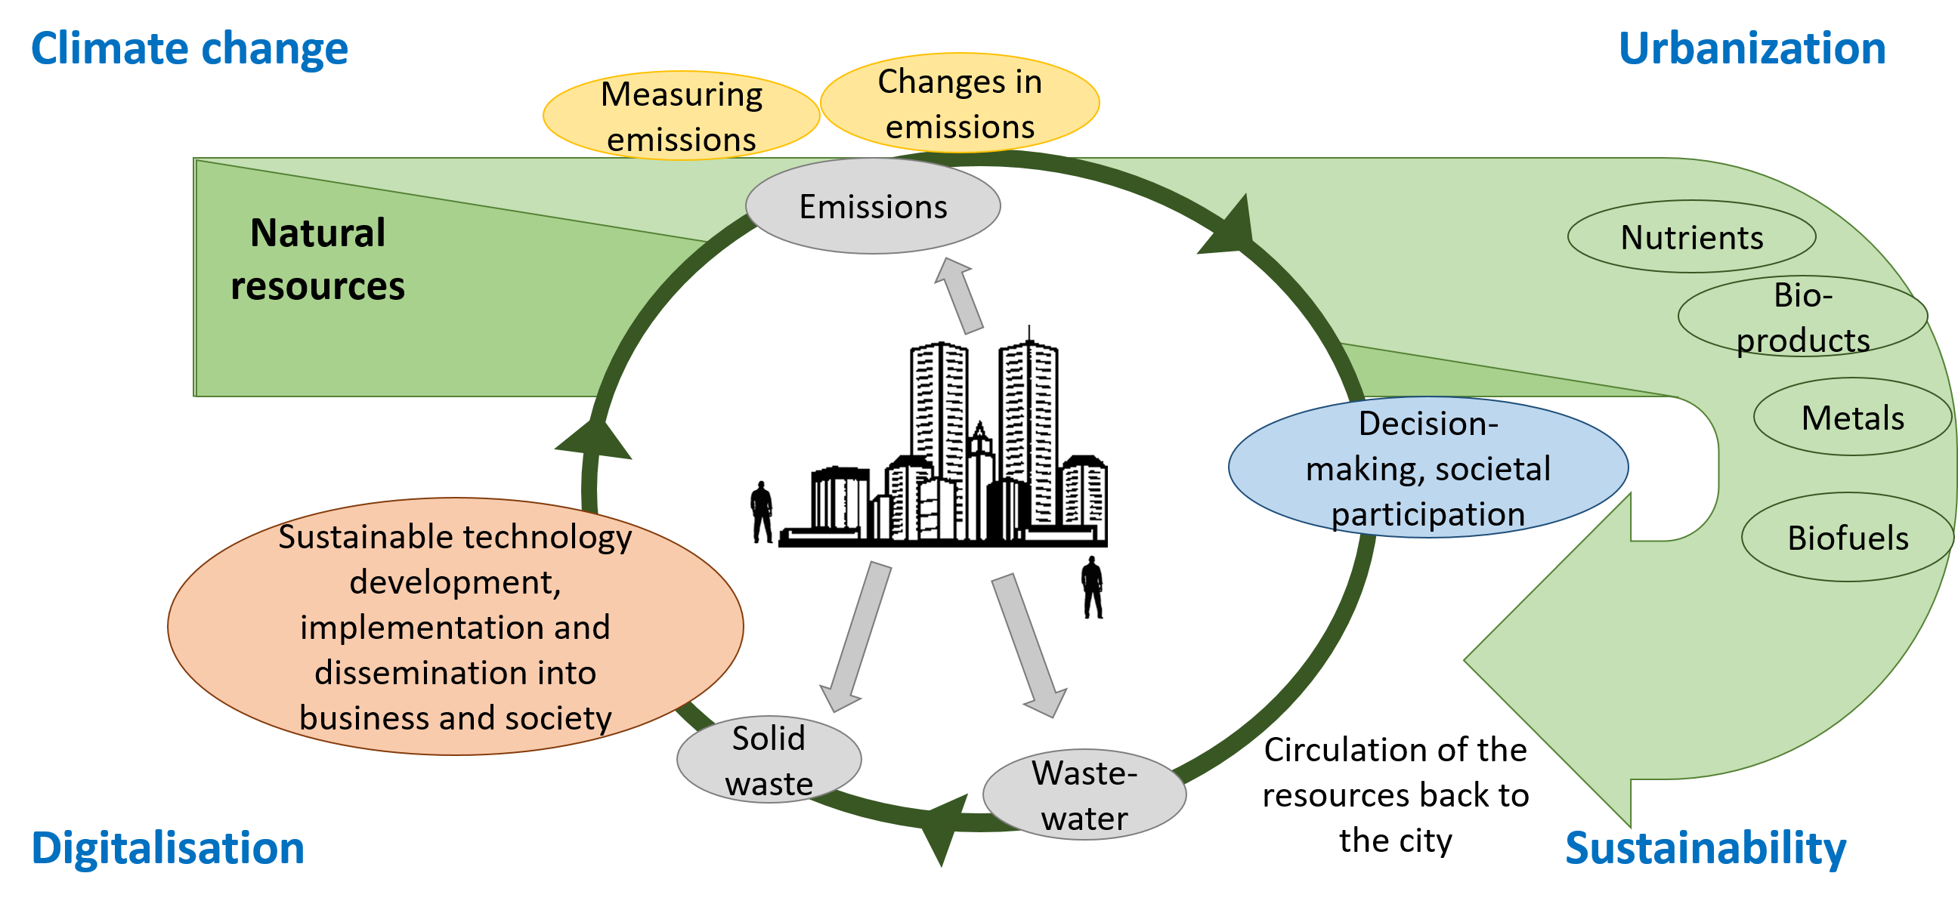
The path from linear to circular economy

Slide 4
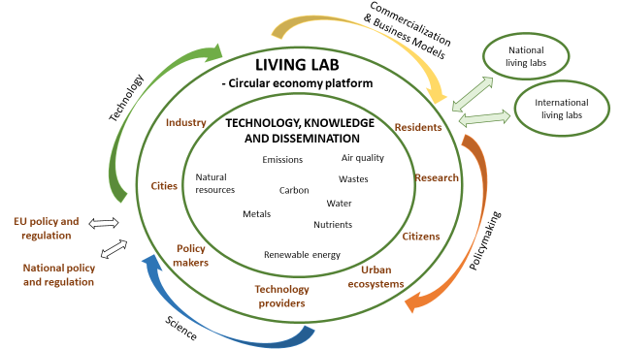
Living labs accelerate circular economy

Slide 5
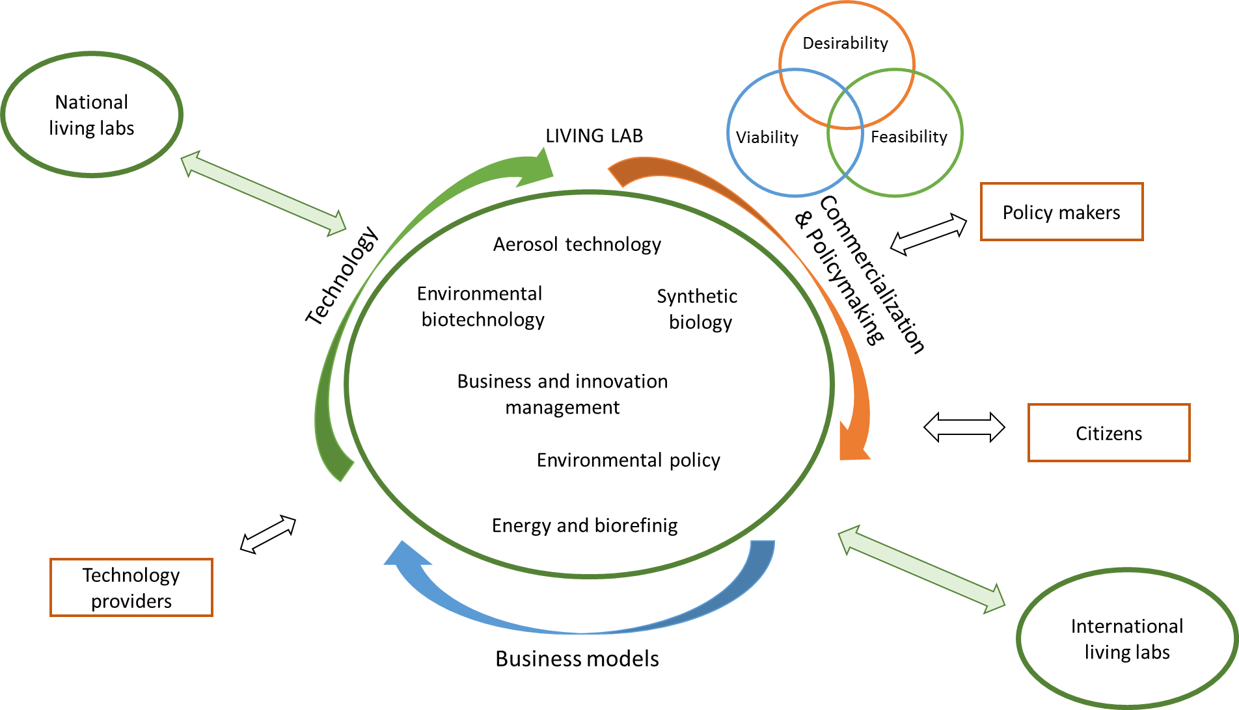
Urban Platform for Circular Economy

Slide 6
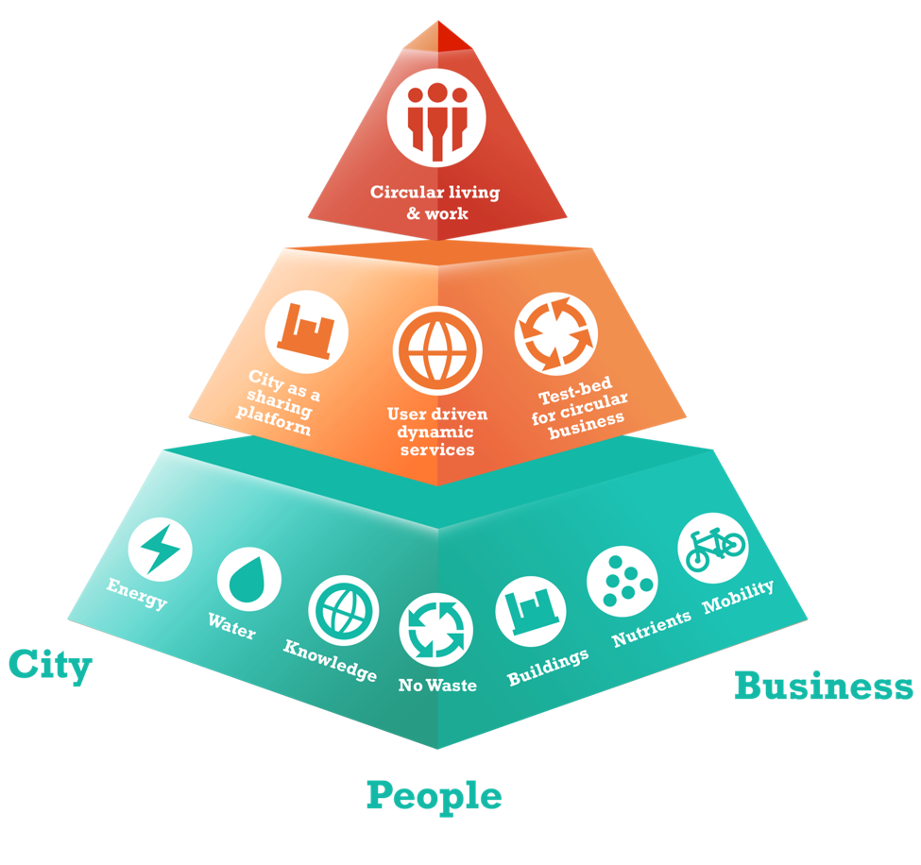
SMART AND SUSTAINABLE CITY DISTRICT OF THE FUTURE TAMPERE, FINLAND

Slide 7
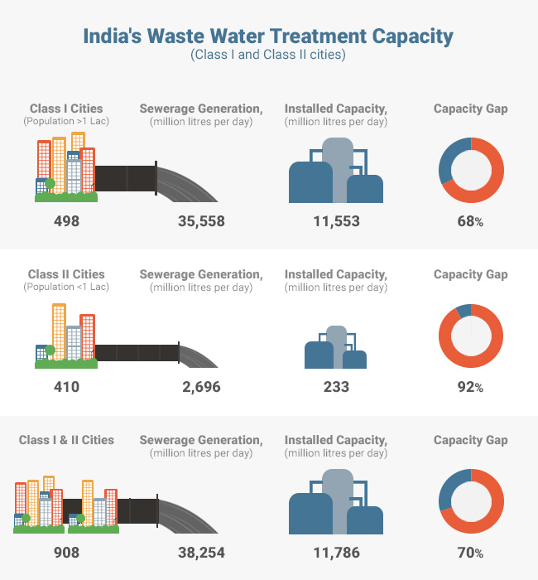
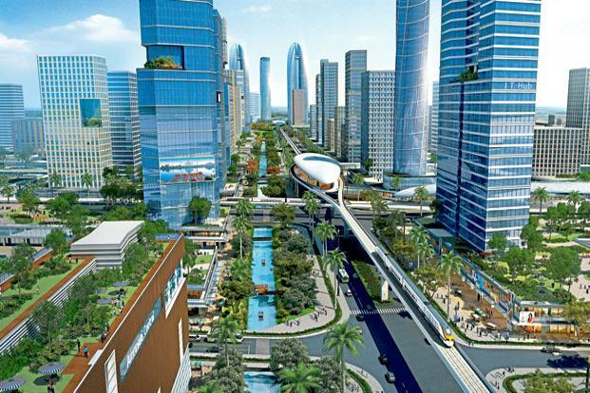
We need global networks of living labs

Slide 8
Urban living labs for circular economy
Urban living labs are used to promote the development, testing and implementation of circular economy approaches to tackle global megatrends
Multidisciplinary approach and participation of different stakeholders accelerate the implementation of knowledge and technologies through simultaneous consideration of societal dynamics and development of new business models
Networking of urban living labs in European and global level is needed to scale up the impact of the developed technological processes and governance innovations

Slide 9
Human Potential Unlimited.

